Slide 1


PROJECT EVE

Slide 2
What’s Been Done

Slide 3
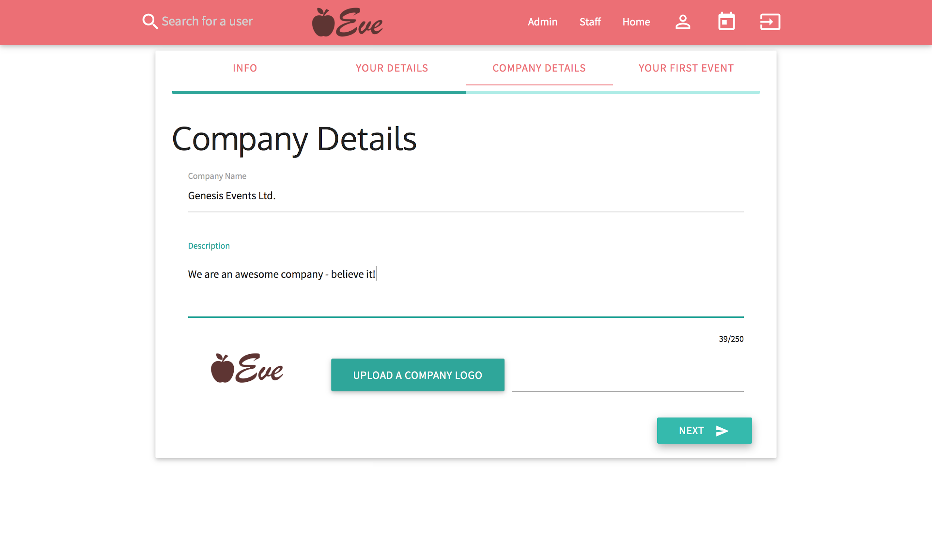
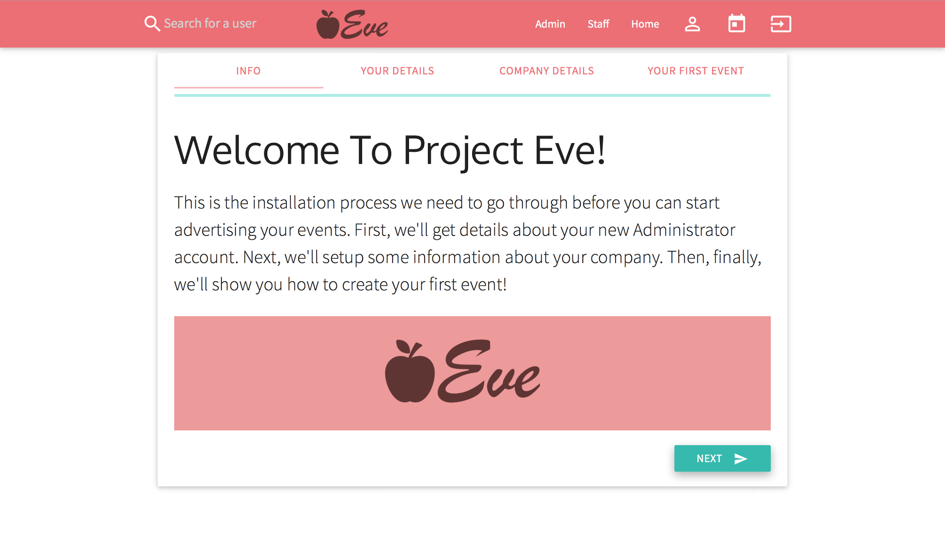
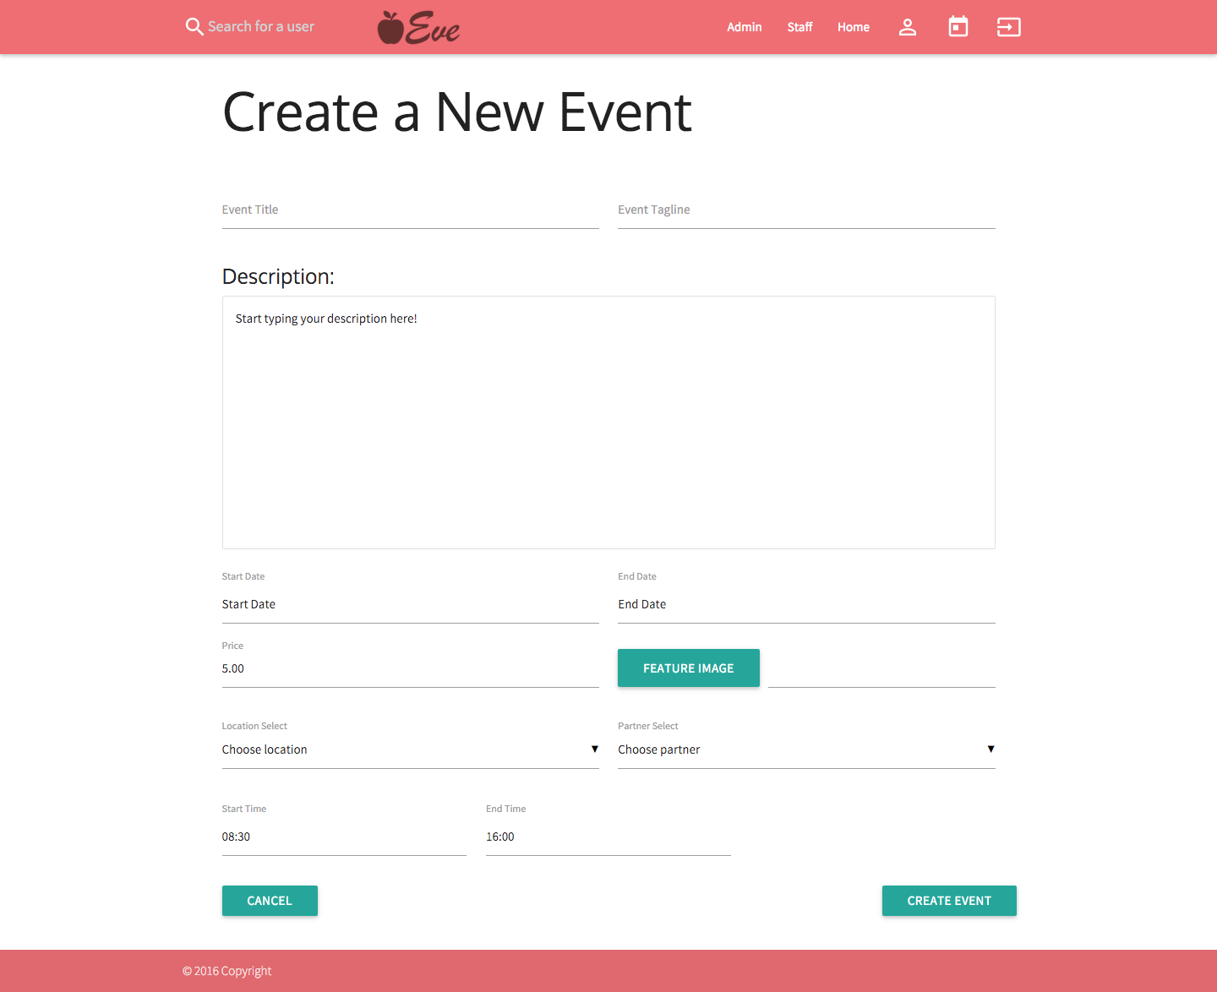
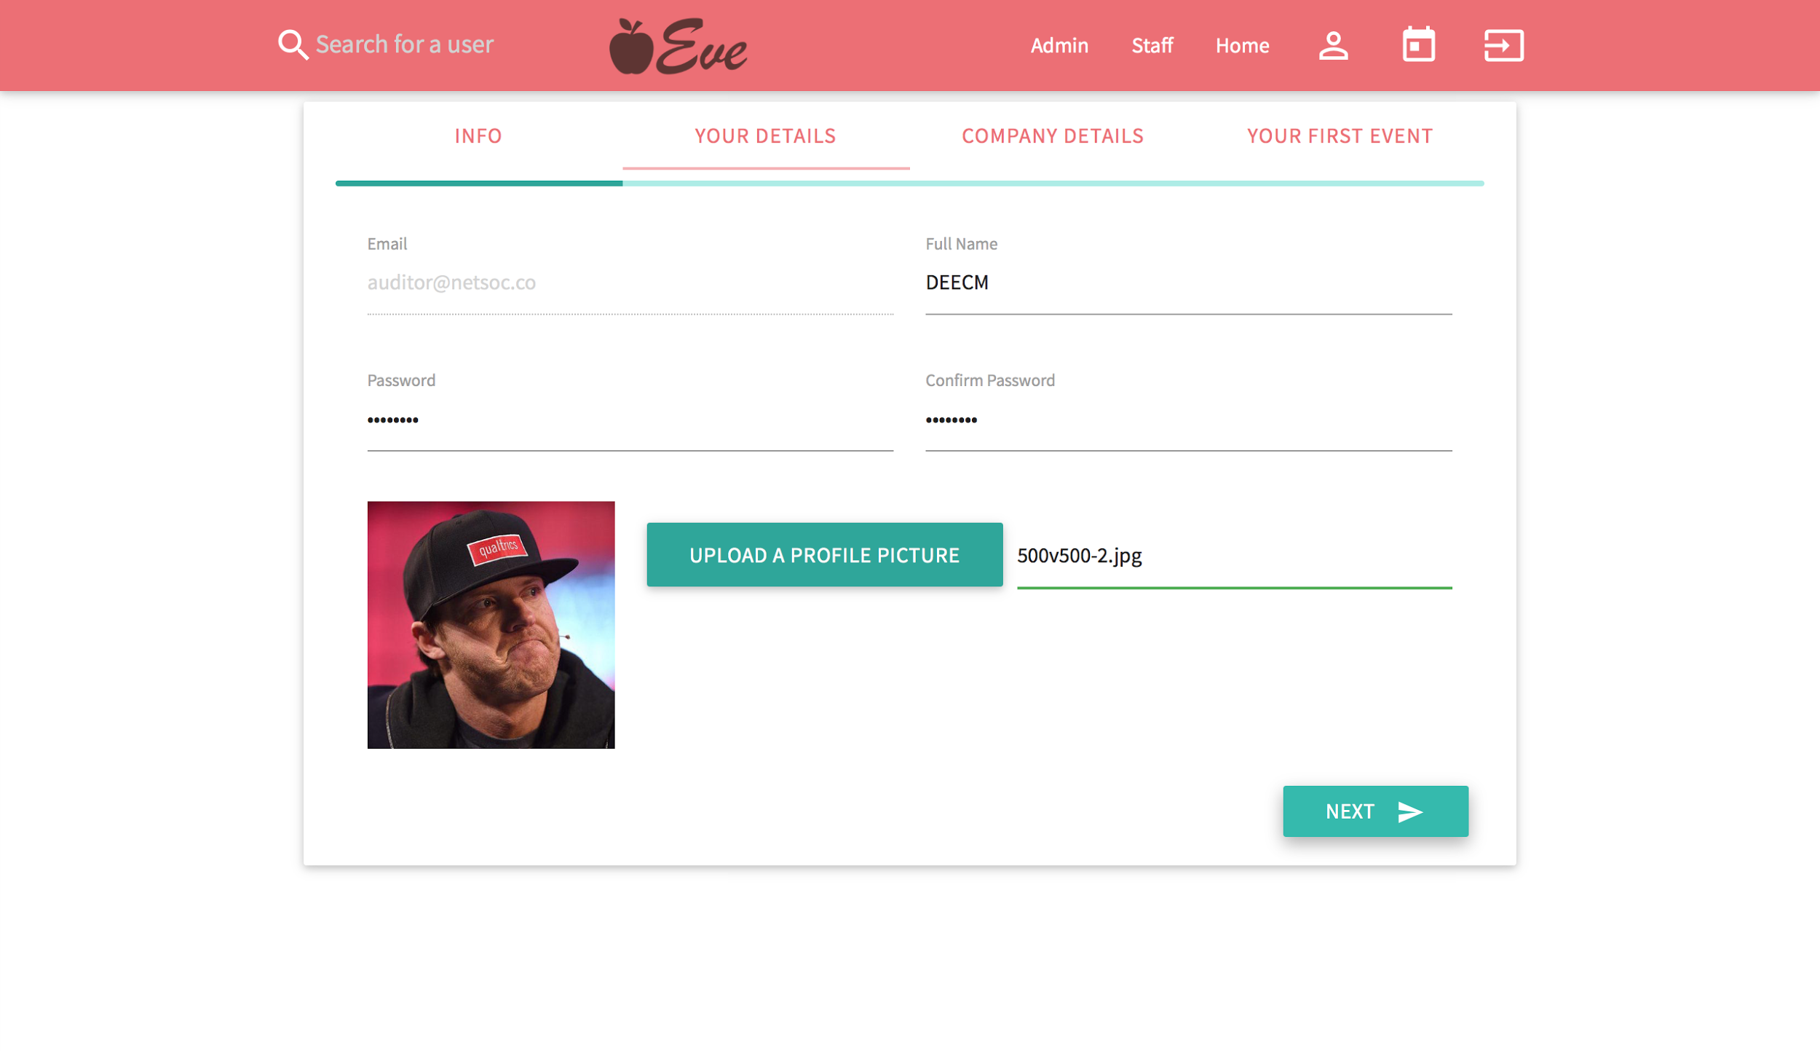
Installation

Slide 4
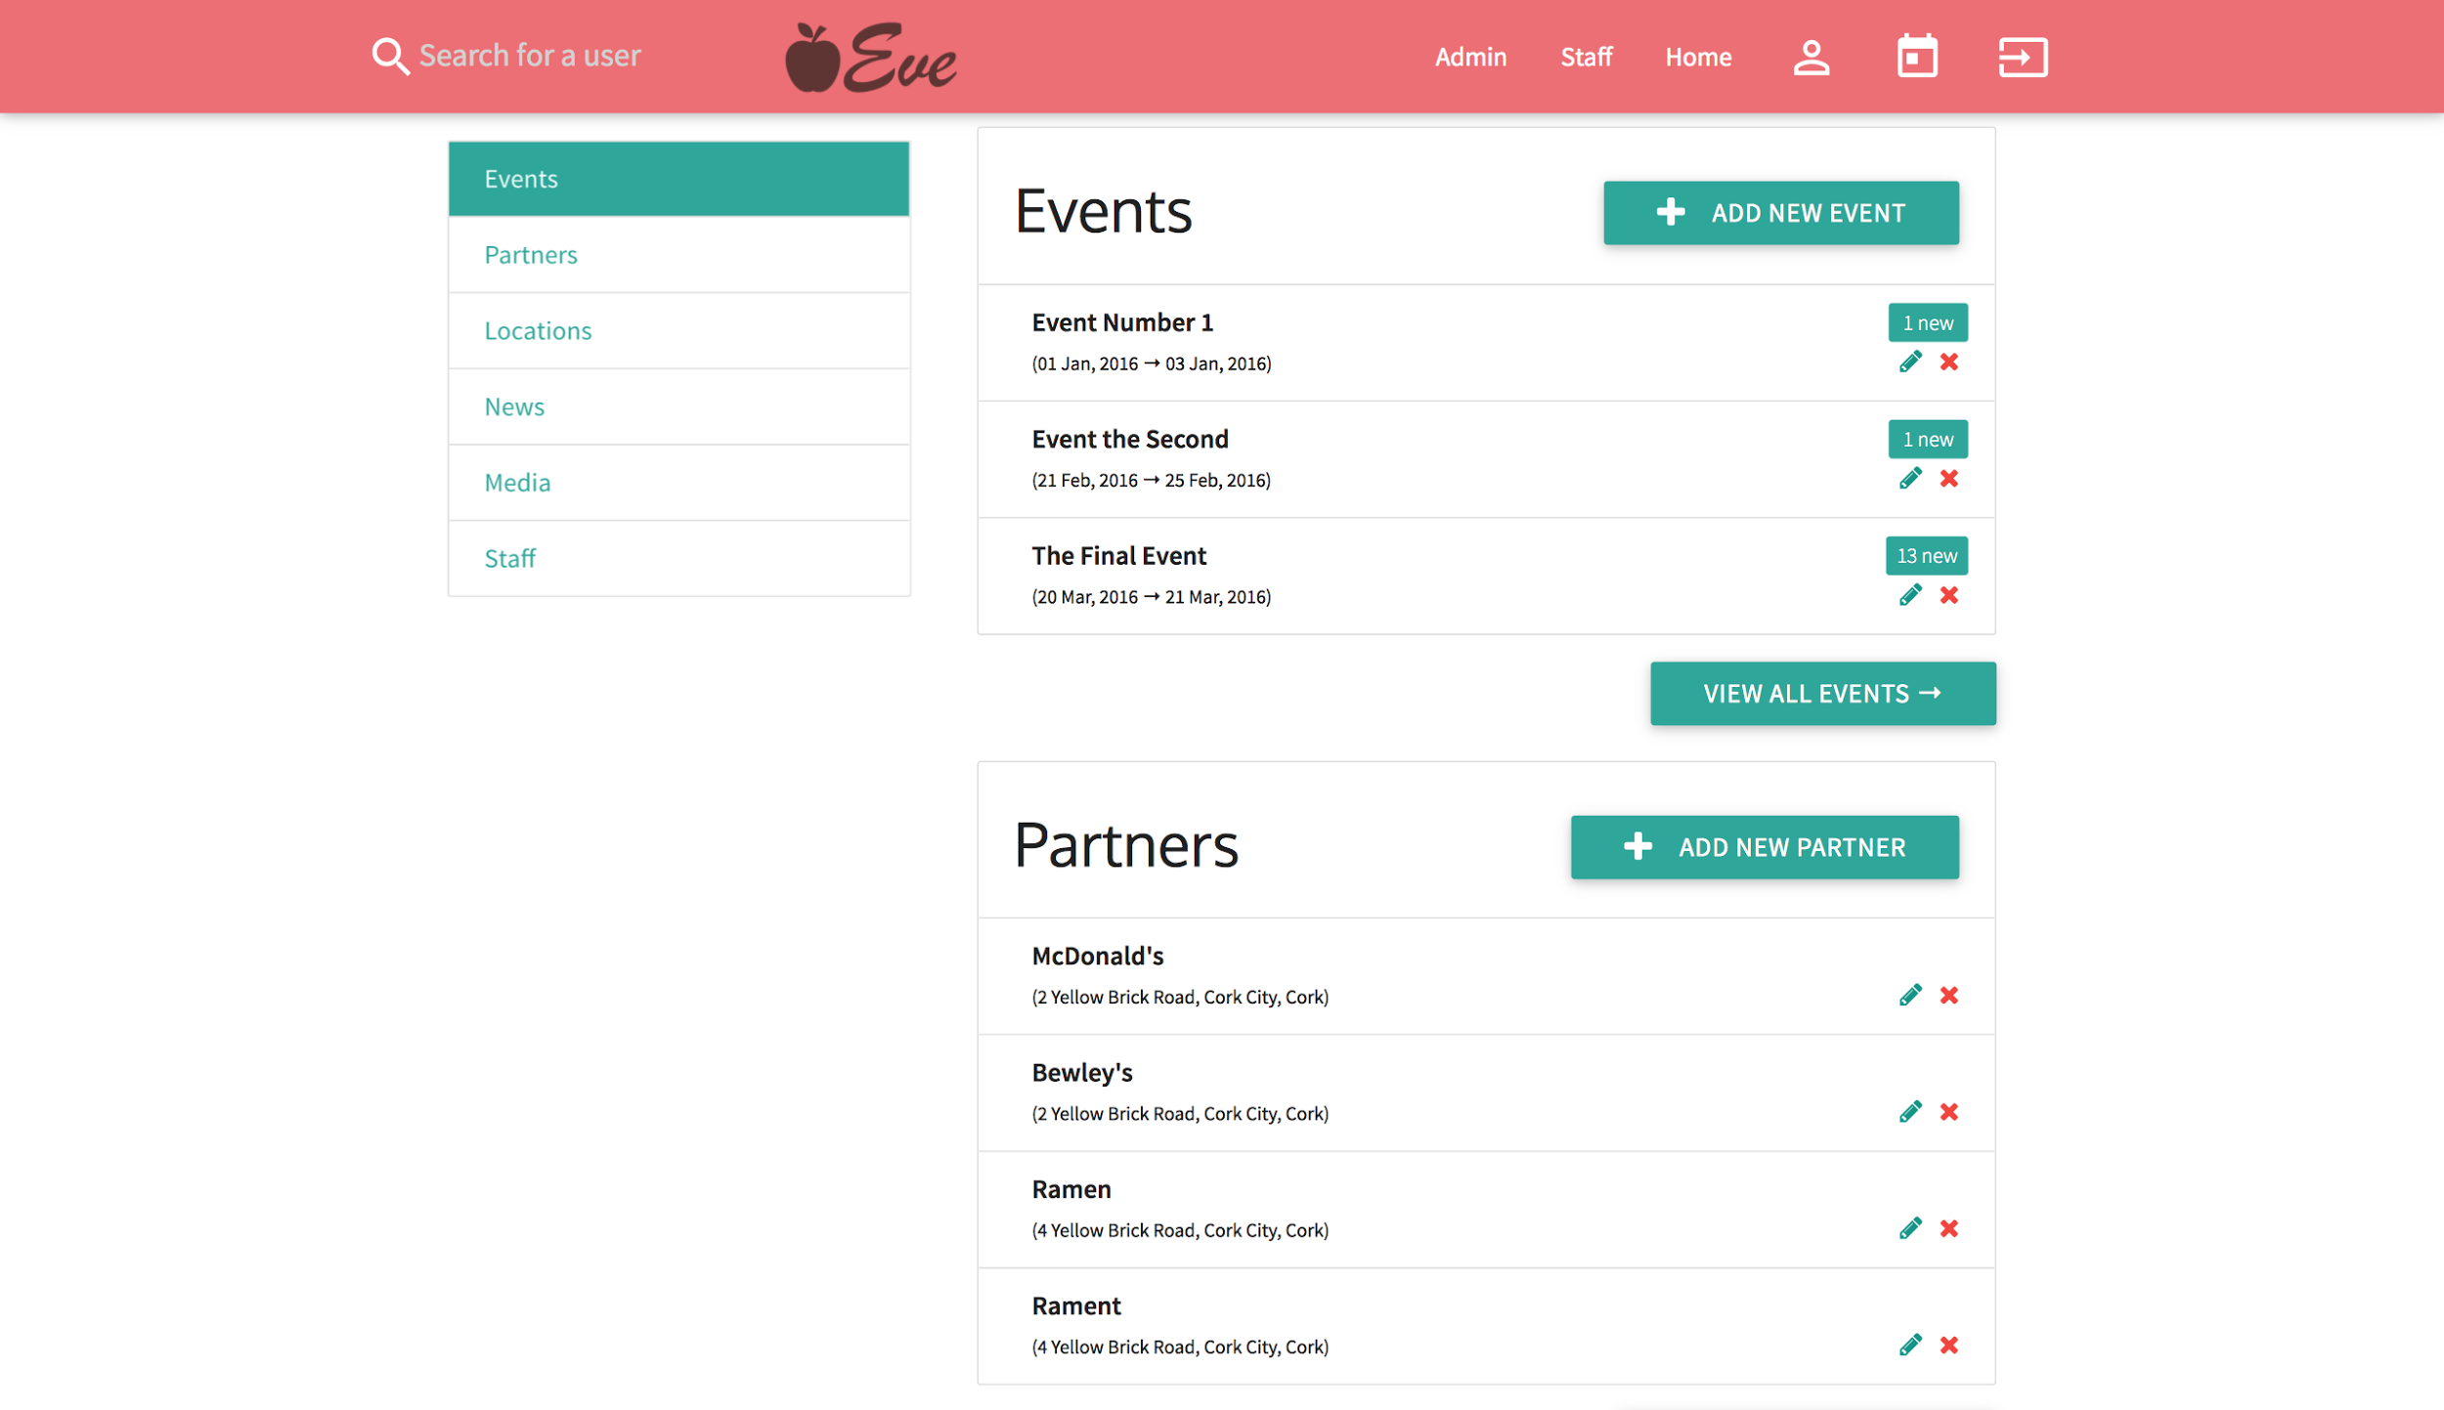
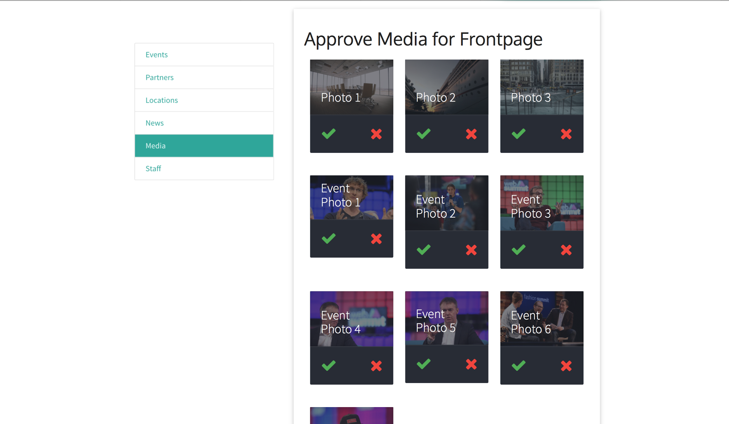
Admin
Events
Partners
Locations
News
Media
Staff

Slide 5
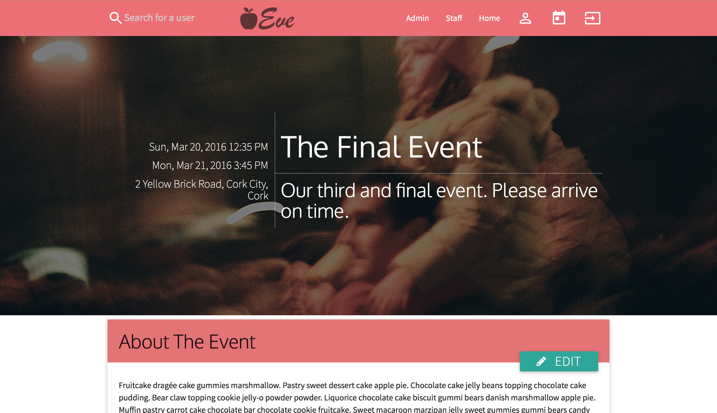
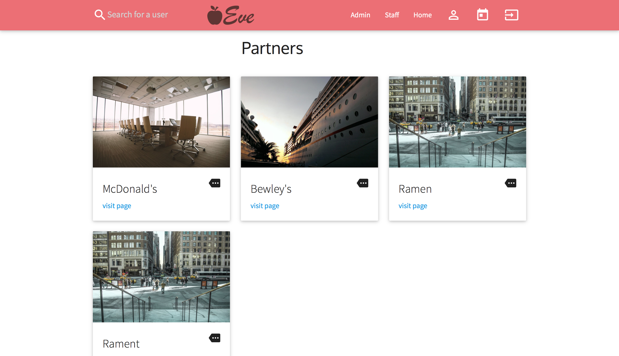
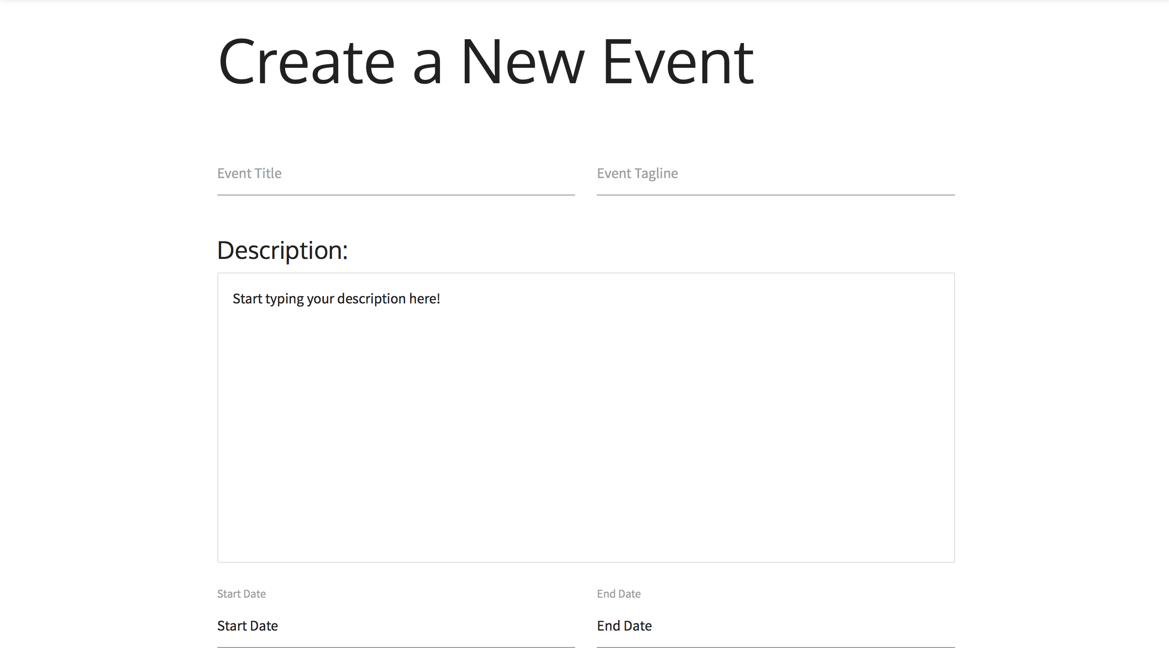
Partner + Events
Separate page for individual events/partners
List view for all events/partners
List of partners associated with each event
Edit events/partners (if admin)
Upload media

Slide 6
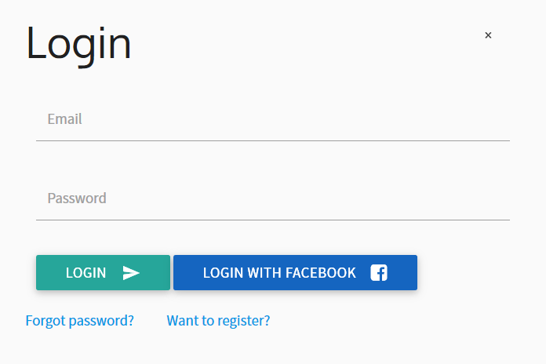
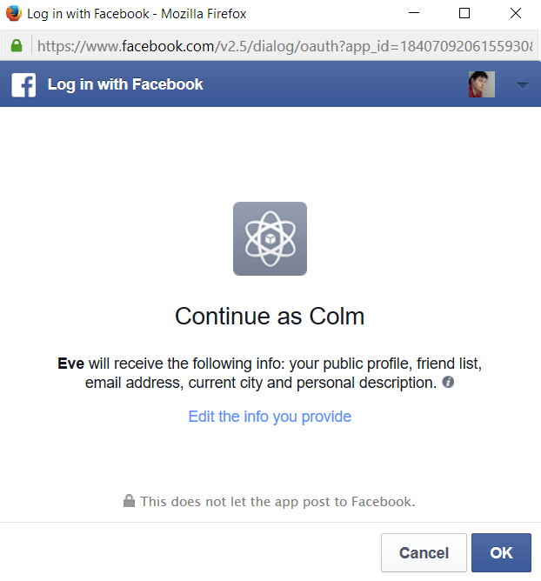
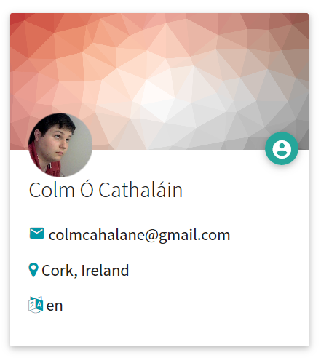
Facebook Integration
We extended Laravel’s user system with Facebook integration.
Users can seamlessly sign in with Facebook
We build an account from their Facebook data
And from then on they can log in immediately using the Facebook button, which will work instantly.
We hope to use this to build in Facebook API data later.

Slide 7
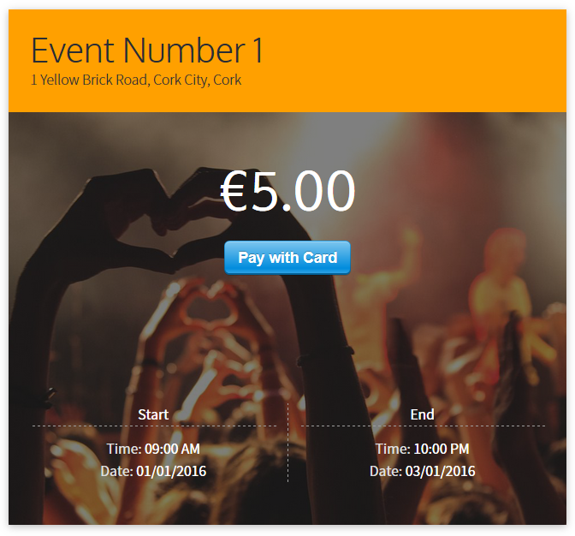
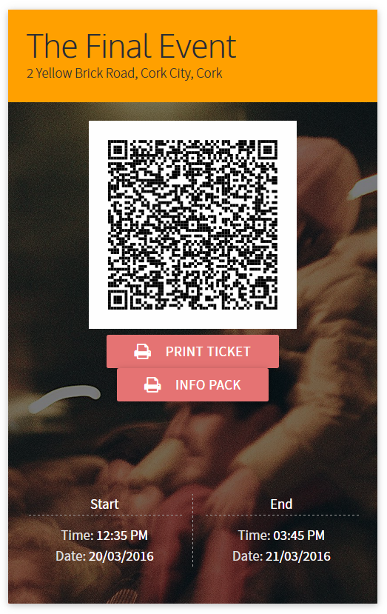
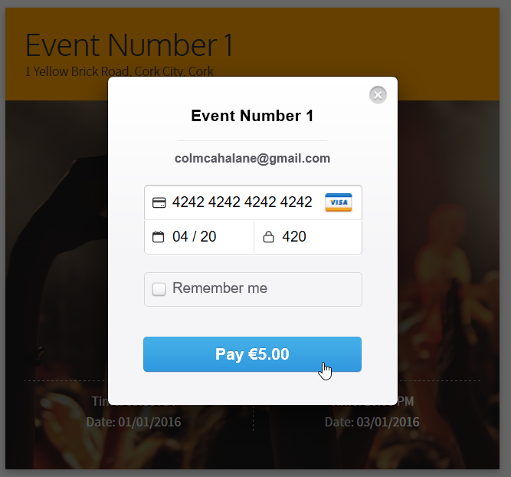
Tickets (+Stripe)
If you’re logged in, the event page comes with a “Pay with Card” button, so you can buy tickets right on that page.
We handle payments with Stripe so the card details never even reach our server, and security is guaranteed.
As soon as you fill out that section, you can access and print out your ticket.
It comes with a QR code which is scanned and verified at the entrance!

Slide 8
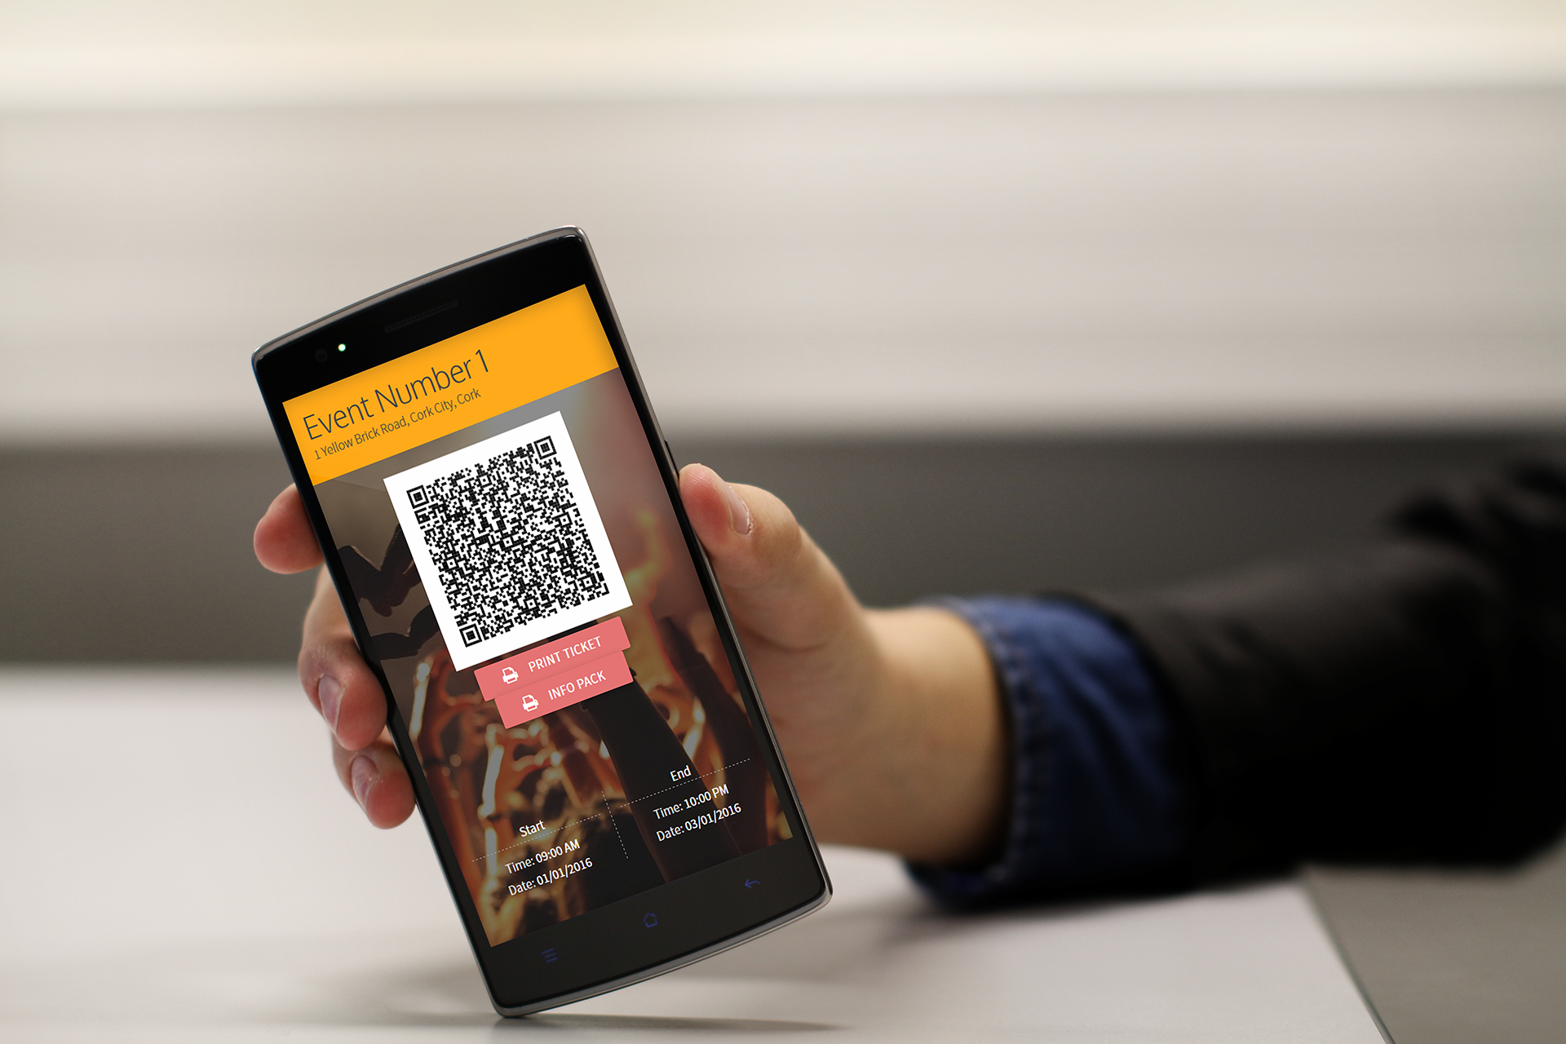
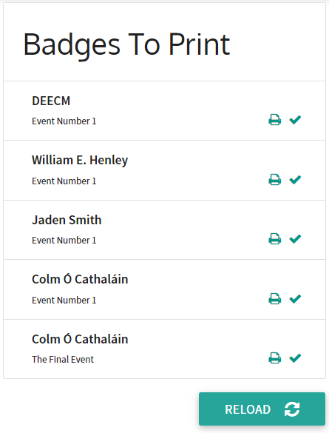
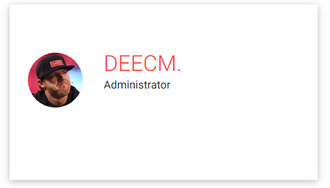
Staff (ticket scanning)
Event staff scan tickets in the form of QR codes on mobile phones; the QR codes are URLs which direct to a secure ticket verification stage.
Attendees may bring their codes on their phones or on printed versions of their tickets.
As their tickets are scanned on phones, they appear in the Staff control panel in real-time, with quick links to print the user’s name badge
This system makes it incredibly easy for staff to manage secure entry and monitor attendance figures.

Slide 9
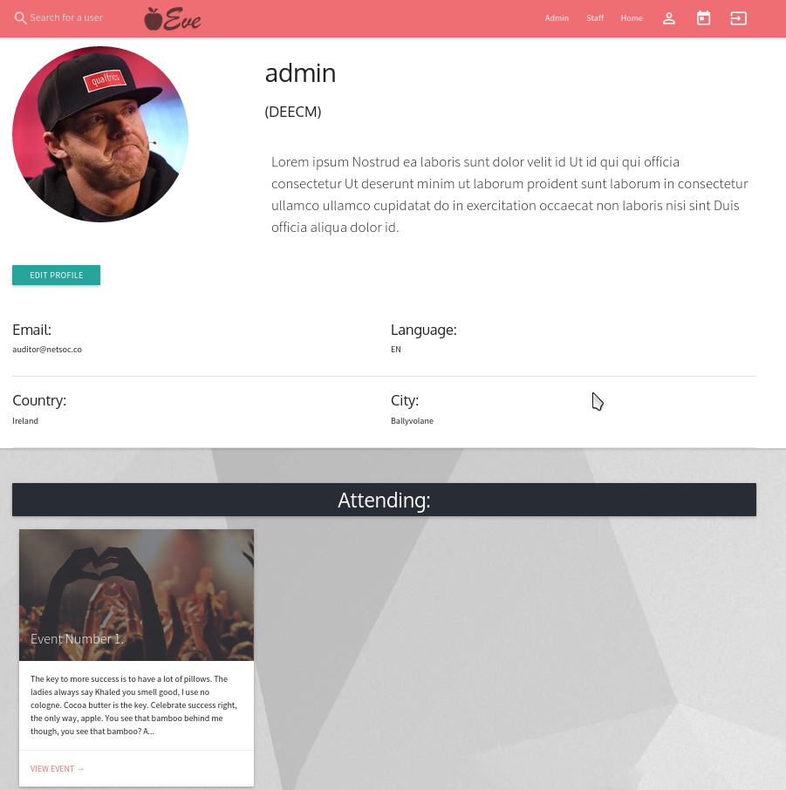
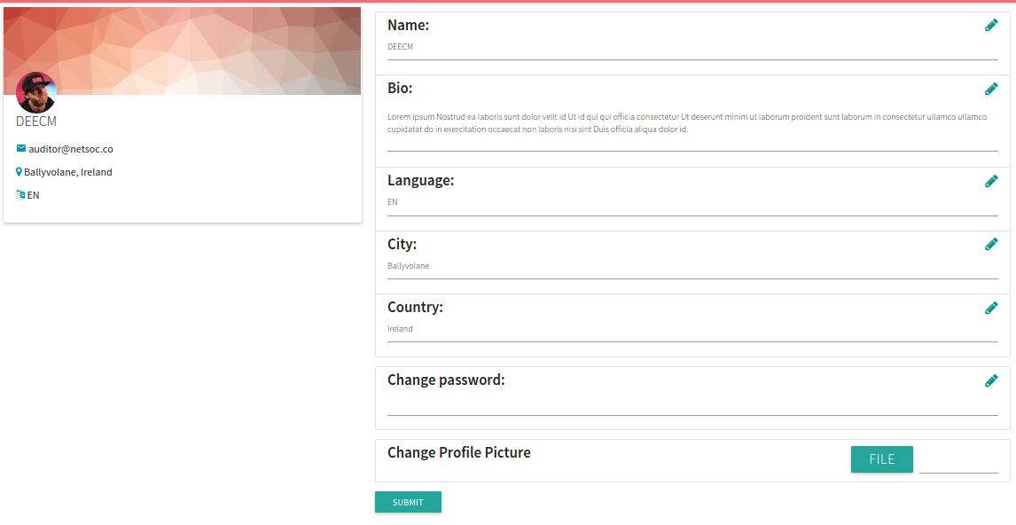
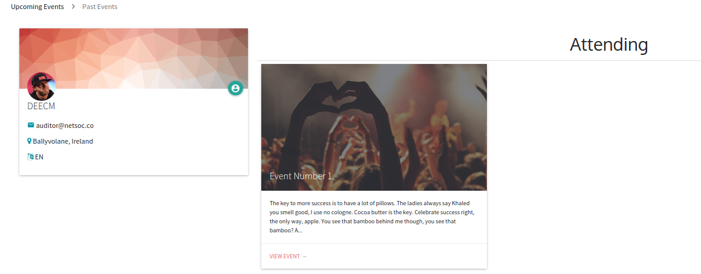
Users
Users have a public profile that can be viewed by anyone.
On their public profile, the owner and the admins have the option to edit the users information.
Users also have two private pages that contain events that they are attending and past events that they have attended.

Slide 10
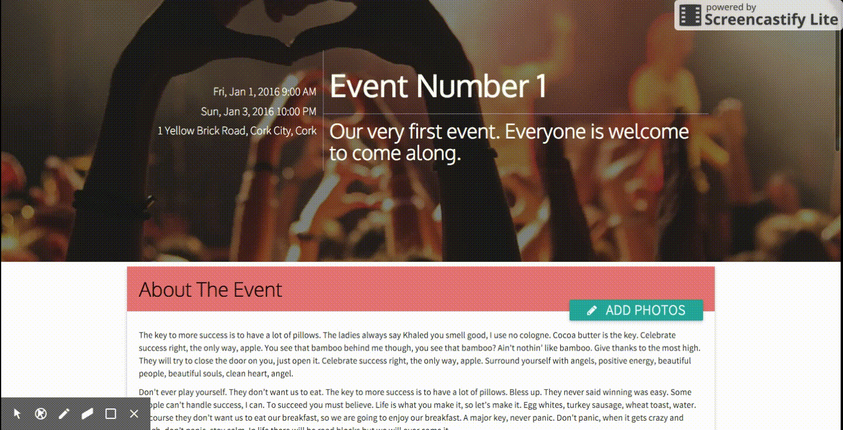
Photo Uploading

Slide 11
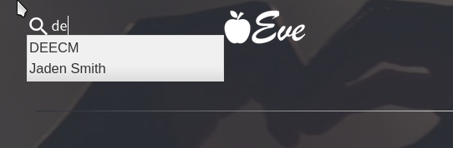
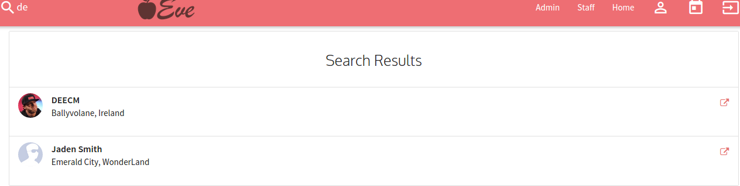
User Search
A search function which allows you to find other users was implemented.
It includes an autocomplete suggestions depending on your current inputted characters into the search bar.
Once you press enter the desired user or list of users will be displayed and you will be given the option to visit one of their public profiles

Slide 12
What We Will Be Doing

Slide 13
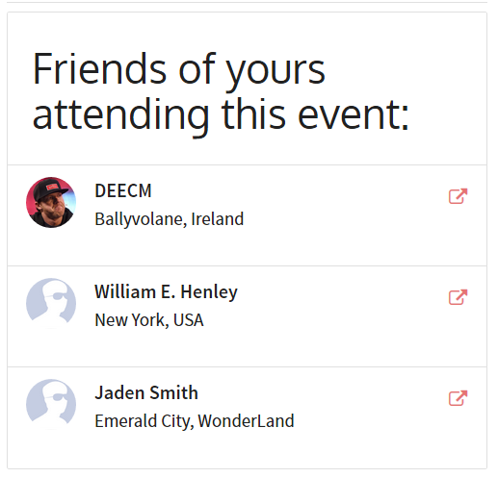
Getting Friends from Facebook
Facebook API gives us access to see user’s friends’ Facebook IDs, and the user’s own Facebook ID…
We can lookup a user’s friends IDs and see if they match any in our database.
This shouldn’t be a difficult process, we imagine we’ll have it done next week
By using our Facebook integration to generate rich, populated user profiles we think this will really enhance the user experience.

Slide 14
Google Maps for Event Locations
Google Maps API
Allow admins to enter in an address when creating an event
with autocomplete
Brings up embedded map
allows admins to move pointer to specific location on map

Slide 15
Google Maps on Tickets
Directions to event
Distance between partners and event location
Using Google API Client
Researching functions such as
Distance matrix
Place search
Place autocomplete

Slide 16
Suggested Partners
Making use of the Google Places API, we’ll suggest nearby locations to partner with
Partners can be stored instantly with the data retrieved from the API
Integrate with other features like Maps Distance Matrix API and Maps Directions API
Data we can retrieve includes:
Name and location
Photo of location
Type of location
Reviews and ratings
Website
A “price level”

Slide 17
Internationalisation
Allowing for the possibility of international visitors
User can specify preferred language
Translates entire site into the specified language of the user
Implemented using Google Translate

Slide 18
How’s the Project Goin’

Slide 19
Progress
We gained time in payment integration so we dedicated leftover time to bug-fixing, testing and documentation
On track with our original milestone projections
We’ve ruled out a lot of unfeasible ideas such as integrating with the TripAdvisor API as it was too restricting.

Slide 20
We’re doing grand
We’re communicating daily about our progress, our errors and our suggestions
Using a framework has been enjoyable and we’ve learned a lot about collaborating on the project via Github
We’re really happy with the design/look & feel of the project

Slide 21
Check Out
projecteve.cloudapp.net

